Slide 1
Branch and Bound

Slide 2
Introduction
Branch and bound algorithms are used to find the optimal solution for combinatory, discrete, and general mathematical optimization problems.
Branching: The main problem is broken into smaller subproblems, forming a tree-like structure where each node represents a partial solution.
Bounding: For each node, the algorithm computes an upper or lower bound on the best possible solution within that subproblem. If this bound is worse than the current best-known solution, the node is pruned (i.e., not explored further).
Pruning: By eliminating branches that cannot yield better solutions than the current best, the algorithm reduces the number of computations, enhancing efficiency.

Slide 3
When to apply Branch and Bound Algorithm
It is appropriate to use a branch and bound approach if the given problem is discrete optimization. Discrete optimization refers to problems in which the variables belong to the discrete set. Examples of such problems include 0-1 Integer Programming and Network Flow problems.
When it comes to combinatory optimization problems, branch and bound work well. An optimization problem is optimized by combinatory optimization by finding its maximum or minimum based on its objective function.

Slide 4
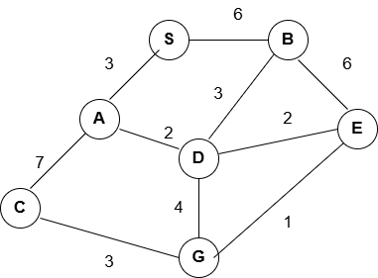
Branch and Bound-Example

Slide 5
FIFO Branch and Bound
First-In-First-Out is an approach to the branch and bound problem that uses the queue approach to create a state-space tree.
In this case, the breadth-first search is performed.
That is, the elements at a certain level are all searched, and then the elements at the next level are searched, starting with the first child of the first node at the previous level.

Slide 6
0/1 knapsack Problem
i | 1 | 2 | 3 | 4
p | 30 | 28 | 20 | 24
w | 5 | 7 | 4 | 2
Capacity=12.

Slide 7
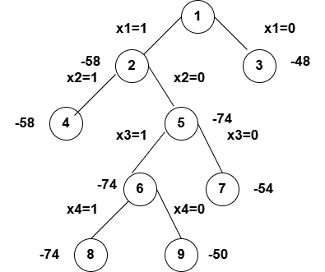
0/1 knapsack Problem-Solution
i | 1 | 2 | 3 | 4
p | 30 | 28 | 20 | 24
w | 5 | 7 | 4 | 2

Slide 8
DP is often better
For classic 0/1 knapsack:
Time complexity: O(n × W)
Guarantees optimal solution
Straightforward to implement

Slide 9
Where Branch and Bound Becomes Useful
Large Capacity (W is huge)
DP depends on W (capacity).
If W = 10⁶ or more then DP table becomes too large (memory + time issue)

Slide 10
Thank You

